Slide 1
VEGGIE TALES
BY WILLIAM WU, ALEX WANG

Slide 2
INTRODUCTION

Slide 3
In a tragic world, you are the only remaining piece of lettuce. Now, other vegetables wants to catch you for your absurd value. As you run and run far away from the other vegetables trying to capture you, you will have to fight and tear to survive.

Slide 4
| Mix of Temple Run and Pokemon
| Platform area where you avoid vegetables and collect new battle moves
| Battle area where you attack and defend with a variety of moves

Slide 5
CODE OVERVIEW

Slide 6

UML DESIGN

Slide 7
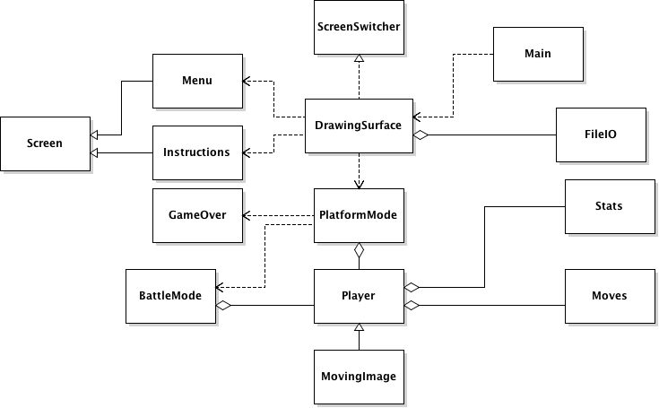

Slide 8

CHALLENGES

Slide 9
| PLATFORM
Finding a way to organize both types of players while maintaining cohesion
Physics and collisions
Side-scrolling
| BATTLE
Multiple screens to switch to
Some status effects were harder to implement
Reducing lag

Slide 10

PACKAGE DESIGN

Slide 11
| veggie.model
MovingImage > Player
Player has Stats and Moves
Stats and Moves represent HP and abilities, respectively
| veggie.screen
ScreenSwitcher > DrawingSurface
Screen > Menu & BattleMode & Instructions & PlatformMode
Main has DrawingSurface
DrawingSurface has all other Screens
| veggie.textReader
FileIO

Slide 12
PROGRAM TEST

Slide 13

INSTRUCTIONS

Slide 14
The goal is to survive as long as you can. During certain periods, your character will enter a battle in which you must defeat your opponent. During this time, you will also effectively be given a break, as all bots are killed off. They will resume spawning when you finish the battle and re-enter the platformer.
As you continue to play, the gaps between each battle will lengthen to make the game progressively harder. If you touch either the bots or go too far off the edge of the screen, you will die.
You can collect red squares while you are playing in platform mode. They will swap out your attacks for new ones, but be warned: these attacks are swapped randomly, and may be weaker than your current ones.

Slide 15

CONTROLS

Slide 16
| PLATFORM MODE
UP - jump up
LEFT - move left
RIGHT - move right
| BATTLE MODE
CLICK PANEL - attack

Slide 17

BUGS

Slide 18
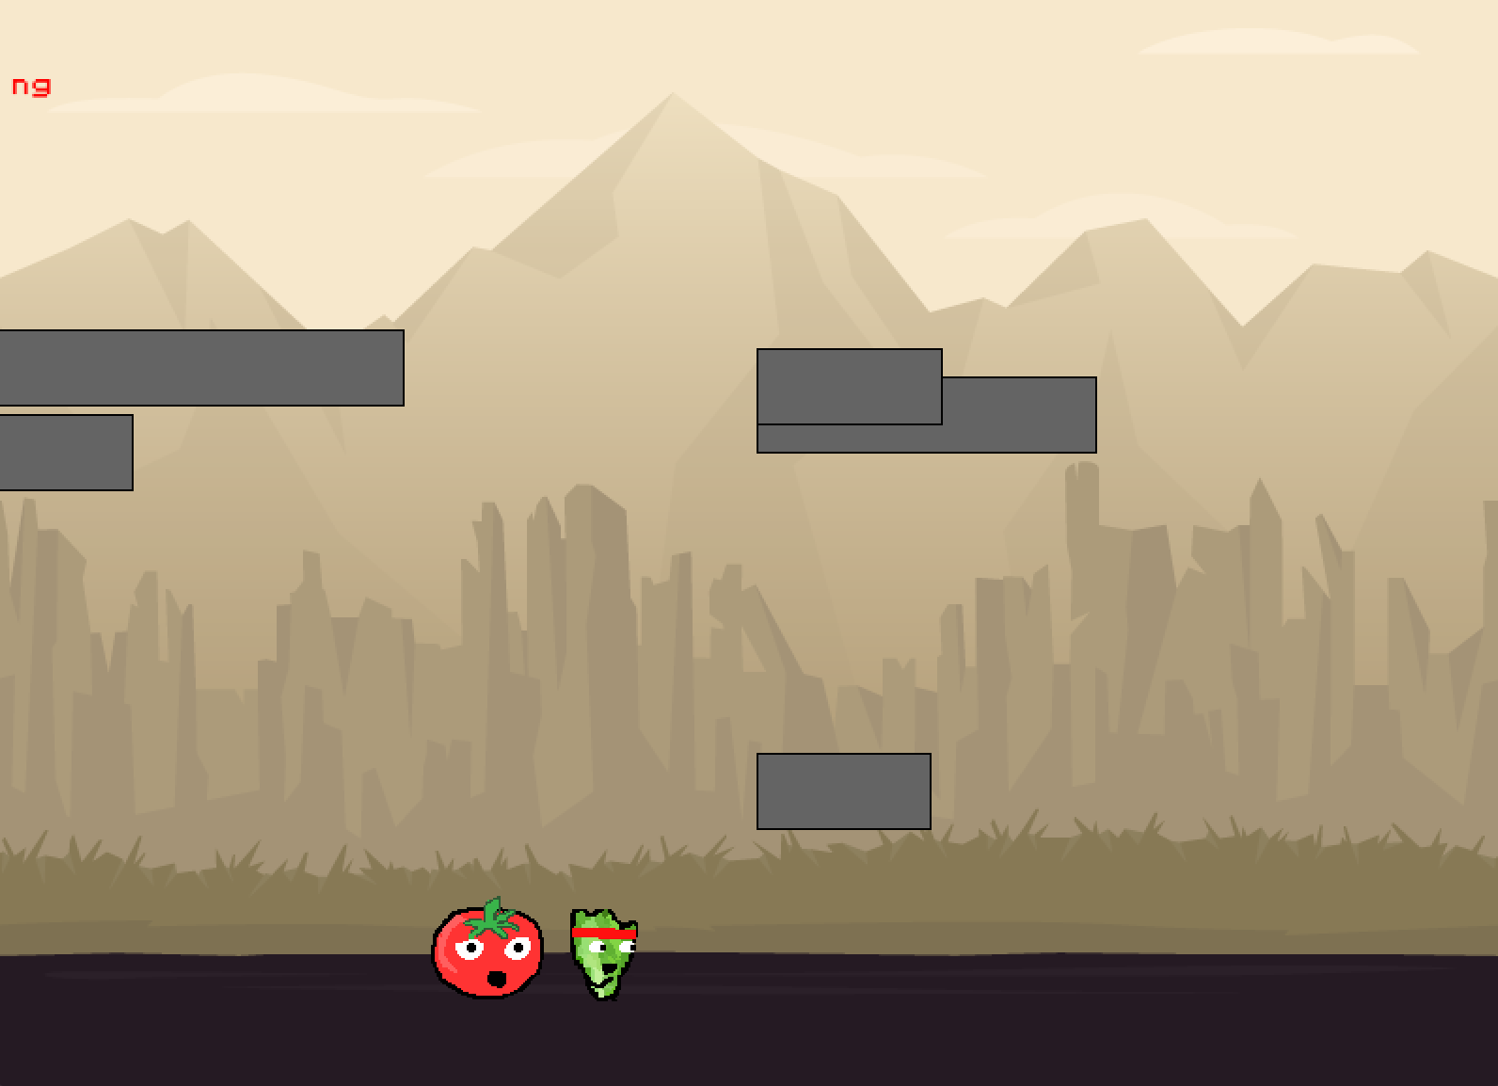
| Some platforms appear to be stacked on one another.

Slide 19

ADDITIONS

Slide 20
| Cooler transitions
| Music
| More battle status effects
| Multiplayer battle
| More animations
| Larger sprites for less blurriness

